Slide 1
Quick look at Common Core
A bit of information about Common Core as promised in St. Leo
Initiated by Council of Chief State School Officers (CCSSO)
National Governors Association Center for Best Practices (NGA Center)
Released June 2, 2010
Two consortia funded by USDOE
Florida leads Partnership for Assessment of Readiness for College and Careers (PARCC)
Take a look at the two websites and the types of assessments each is proposing

Slide 2
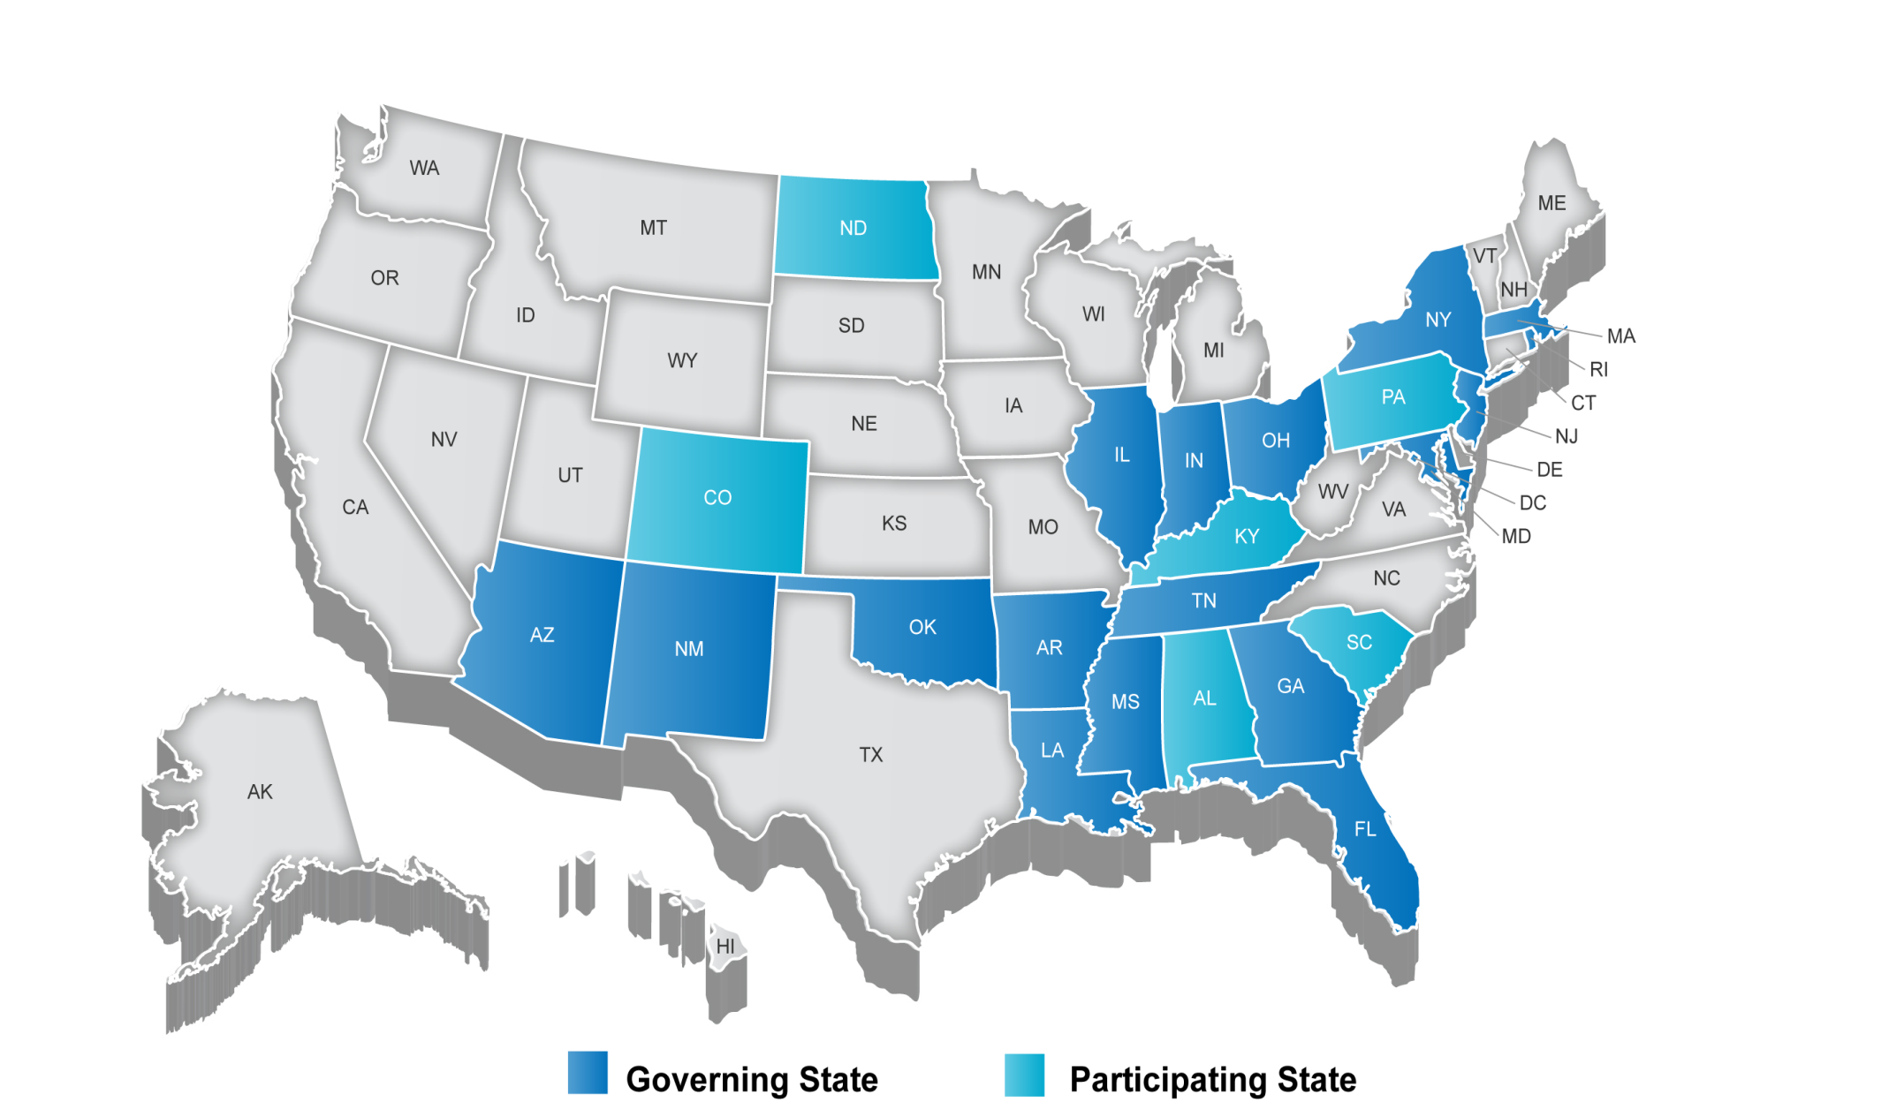
Partnership for Assessment of Readiness for College and Careers (PARCC)
186 million assessment grant from RTTT
http://www.parcconline.org
Fiscal Agent: Florida DOE

Slide 3
SMARTER Balanced Assessment Consortium SBAC) http://www.k12.wa.us/SMARTER/default.aspx $ 176 million assessment grant from RTTT Fiscal Agent: Washington State DOE

